Slide 1

Sigur Ecommerce Pvt. Ltd.
(eBusiness Enabler)
Company Profile

Slide 2

About Company
◆ Sigur Ecommerce Pvt. Ltd. is an IT Solution Provider.
◆ We operate primarily on India and Malaysia Markets.
◆ Resources with 16+ Years of Experience in Software Industry.
◆ Established in Year 2012.
◆ Certified Project Managers, Software Engineers.
◆ Solid Experience in Software Development Life Cycle.

Slide 3
Mission and Vision
◆ Mission (For Our Clients)
◆ Our mission is to create superior value through our technology solutions, our
business counsel and effective implementation.
◆ By so doing, we help them achieve their business goals.
◆ Mission (For Ourselves)
◆ Our mission is to become established among the business community for our innovativeness and our rich knowledge in matching business needs with the right technology solutions.
◆ Through our innovation, we will create value for our shareholders and provide exciting new growth opportunities for our people.
◆ Vision
◆ To provide our clients with best-in-class technology and solutions from our base knowledge, ideas, research and innovations.

Slide 4
Why Us ?
We Provide the best solutions to
Maximize return on your IT investments | Increase your business growth | Optimize system performance and reduce costs.

Slide 5
Our Advantages
◆ Minimize Application Licenses Investment
◆ Sigur Ecommerce provides services using open source tools that enable minimum license investment.
◆ Source Codes Ownership for Internal Distribution.
◆ Sigur Ecommerce provides source codes upon delivery of services that enables the customers to continue enhancements and modifications of business applications.
◆ * The source codes are strictly prohibited for commercial distribution.
◆ Speedy and Quality Deployment.
◆ Sigur Platform provides ready components and engine that just need to integrate to formulate business application.
◆ Sigur Ecommerce enables build to fit business solutions in reasonable timeline and superior quality.

Slide 6
Target Industries
Engineering
Corporate Management (ERP, CRM, IT Infra & Security)
Retail and Consumers
Healthcare

Slide 7


Services
IT & Project
Consulting
Search Engine Optimization
Software Development
Application Development
Business Continuity
Business Consultancy
Data Quality Services
Ecommerce Solution
IT Business Process Outsourcing
Database
Management
& Analysis

Slide 8


IT & Project Consulting
Business Process Analysis
Maximize return on your IT investments
Increase your business growth
Optimize system
performance
Reduce costs
Audit IT Systems
Development of IT Infrastructure Strategy for Customer
Recommendations to improve
the customer’s IT Department

Slide 9
IT & Project Consulting Allows
◆ To Develop a common strategy for development of the IT Department in the Customer’s company.
◆ Optimize the cost of support and development of existing
information system.
◆ Create conditions for the proper response of IT systems to business needs and there by achieve a competitive advantage of the customer.
◆ Improve Efficiency of the IT Department in the Company of the Customer by Optimizing the development and testing of the IT systems.

Slide 10


Software Development
◆ Identification of Business value
◆ Requirements gathering
◆ Requirement Elaboration
◆ Prototyping
◆ System Design and Technical Architecture Development
◆ Development
◆ Application Testing
◆ Delivery and Implementation
◆ Maintenance and Support
◆ Performance Tuning
Full Cycle of Process is Covered
Possibility to Join at any Stage of the Process
Services of any Separate Stage of the Process

Slide 11


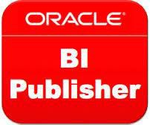






Technology & Platform

Slide 12







Open Source Business Solutions

Slide 13
IT Business Process Outsourcing
◆ Application Support and Maintenance
◆ Software Product Development / R&D Processes
◆ Project Management
◆ QA and IT Audit Processes
◆ Corporate Document Management & Monitoring
◆ Corporate Portal Content Support & Data Entry
◆ Database Management & Performance Tuning
◆ IT Security Support & Analysis
Do What you do best and Outsource the Rest !!!!

Slide 14


Database Management & Analysis
Data warehousing
Data Consolidation from Multiple Sources
Data De-duplication and Validation
Data Extraction, Transformation & Loading (ETL)
Data Cleansing
Data discovery and thorough understanding of Customer Data
Relevant Customer Segmentation Models
Data Mining
Database Administration
Data Analysis
Database
Migration

Slide 15


Ecommerce Solutions
Shopping Cart
Multi-lingual and Multi Currency
Support Multiple Shop
Efficient Order Management
Search Engine Friendly
PayPal Integration
Other Payment Gateway Integration
Order Fulfillment
Payment Gateway Integration
Product Catalog Management
Customer
Support
Warehouse Inventory Management

Slide 16


Our Products
IT Infrastructure Management
Library Management System
Corporate ERP Solutions
Entirely Web-based.
Configurable
Customizable
Compatible with all browser
Downloadable Reports
Role Based Authorization
Audit Trail of data changes
SQL Injection Prevention
Shopping Carts
Laboratory Management System
E-Document Management System
Online Exam
CRM Solutions

Slide 17

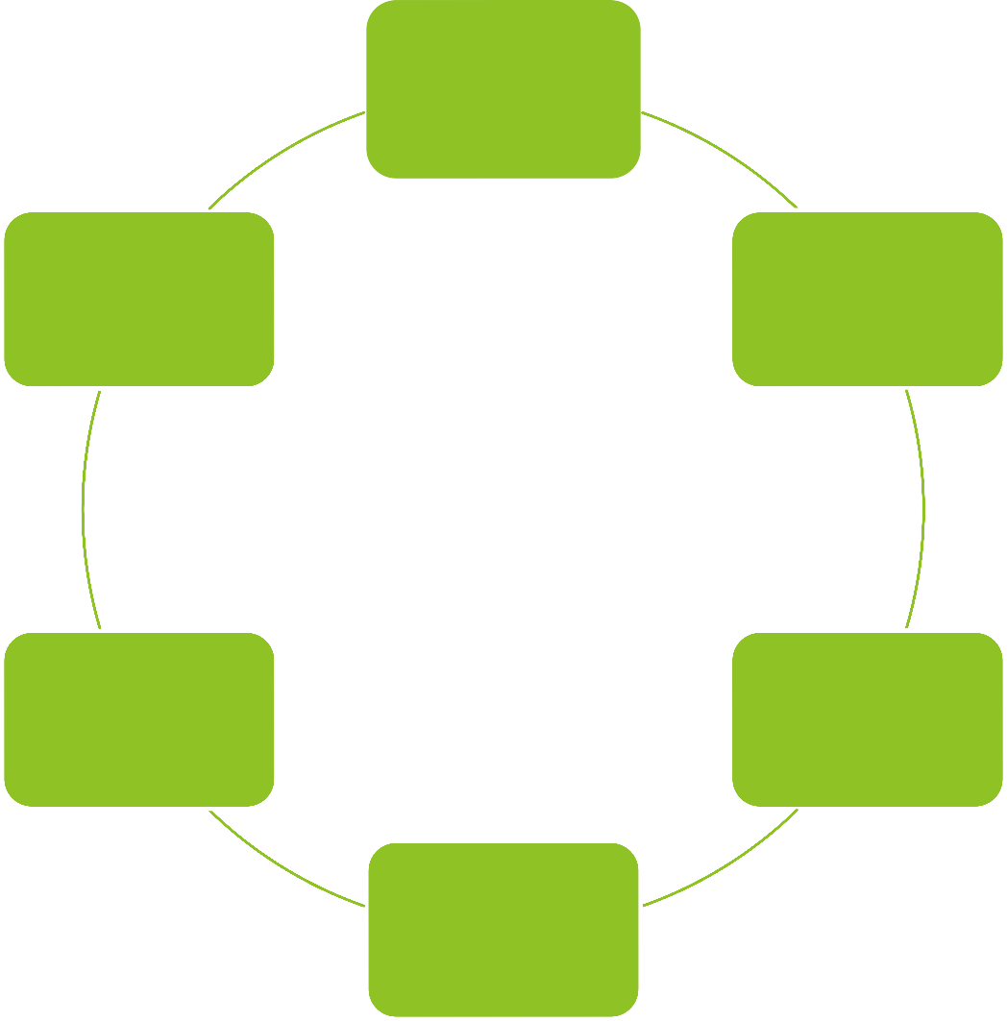

Corporate ERP Solutions
Human Resource Management
Improves Collaboration
Cost Management
Improved Visibility of Inventory
Project Tracking
Financial Accounting System
Store and Inventory Management
Issue Tracking
Business Management
Project Management
Copyright Sigur Ecommerce. All Rights Reserved
17

Slide 18
Corporate CRM Solutions
Lead Management
Sales Force Automation
Customer Support
Target List for Campaign
Predictive Analysis
Performance Matrix
Trouble Tickets
Campaign Management
Opportunity Tracker
Customer Segmentation

Slide 19








Customers & Partners
Visiontek

Slide 20
Thank You

